Slide 1

Reading Spine 2025 - 26
The aim of this reading spine is to provide a list of books / texts that staff can use in their own planning. These may be used as focus texts, class stories, to support curriculum areas and accessible to the children in reading areas.
The intention is, that by the time they leave Grasslot Infant School, our children will have developed a wide, rich vocabulary and broader knowledge of the world in which we live.
As well as linking to our topics, every book / text on this reading spine has been chosen for a purpose. These include texts that:
* feature rhyme and rhythm
* feature repetitive memorable events that encourage prediction
* positively reflect the children's interest and background
* allow children to practise their decoding skills and independent reading
* widen the children's knowledge of the world and society
* are written by skilful and experienced authors
*** Our reading spine is in its infancy and is an ever-evolving document which will consider new releases along with texts recommended through CPD and professional discussions ***
"...it is essential that children are read to and engage in rich discussion of texts from the very beginning of their time in school."
Christopher Such 2021

Slide 2
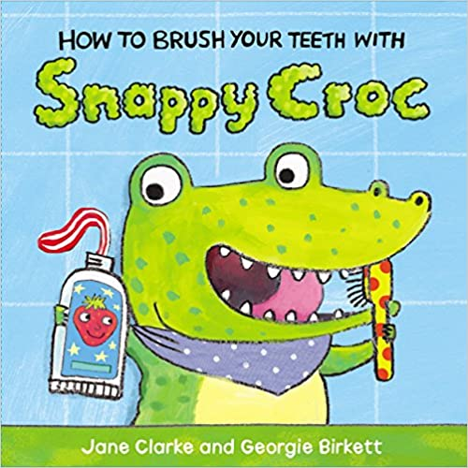



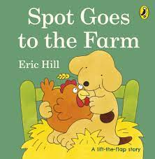
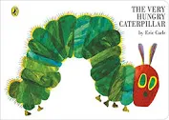
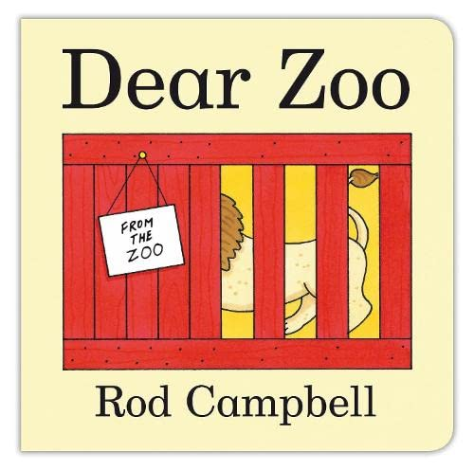



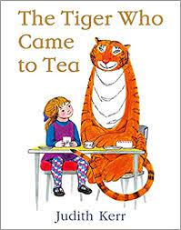
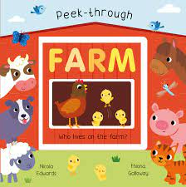
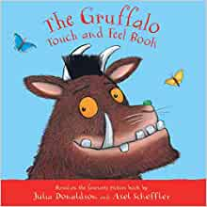
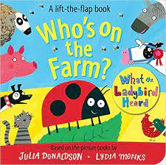
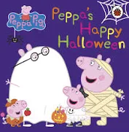
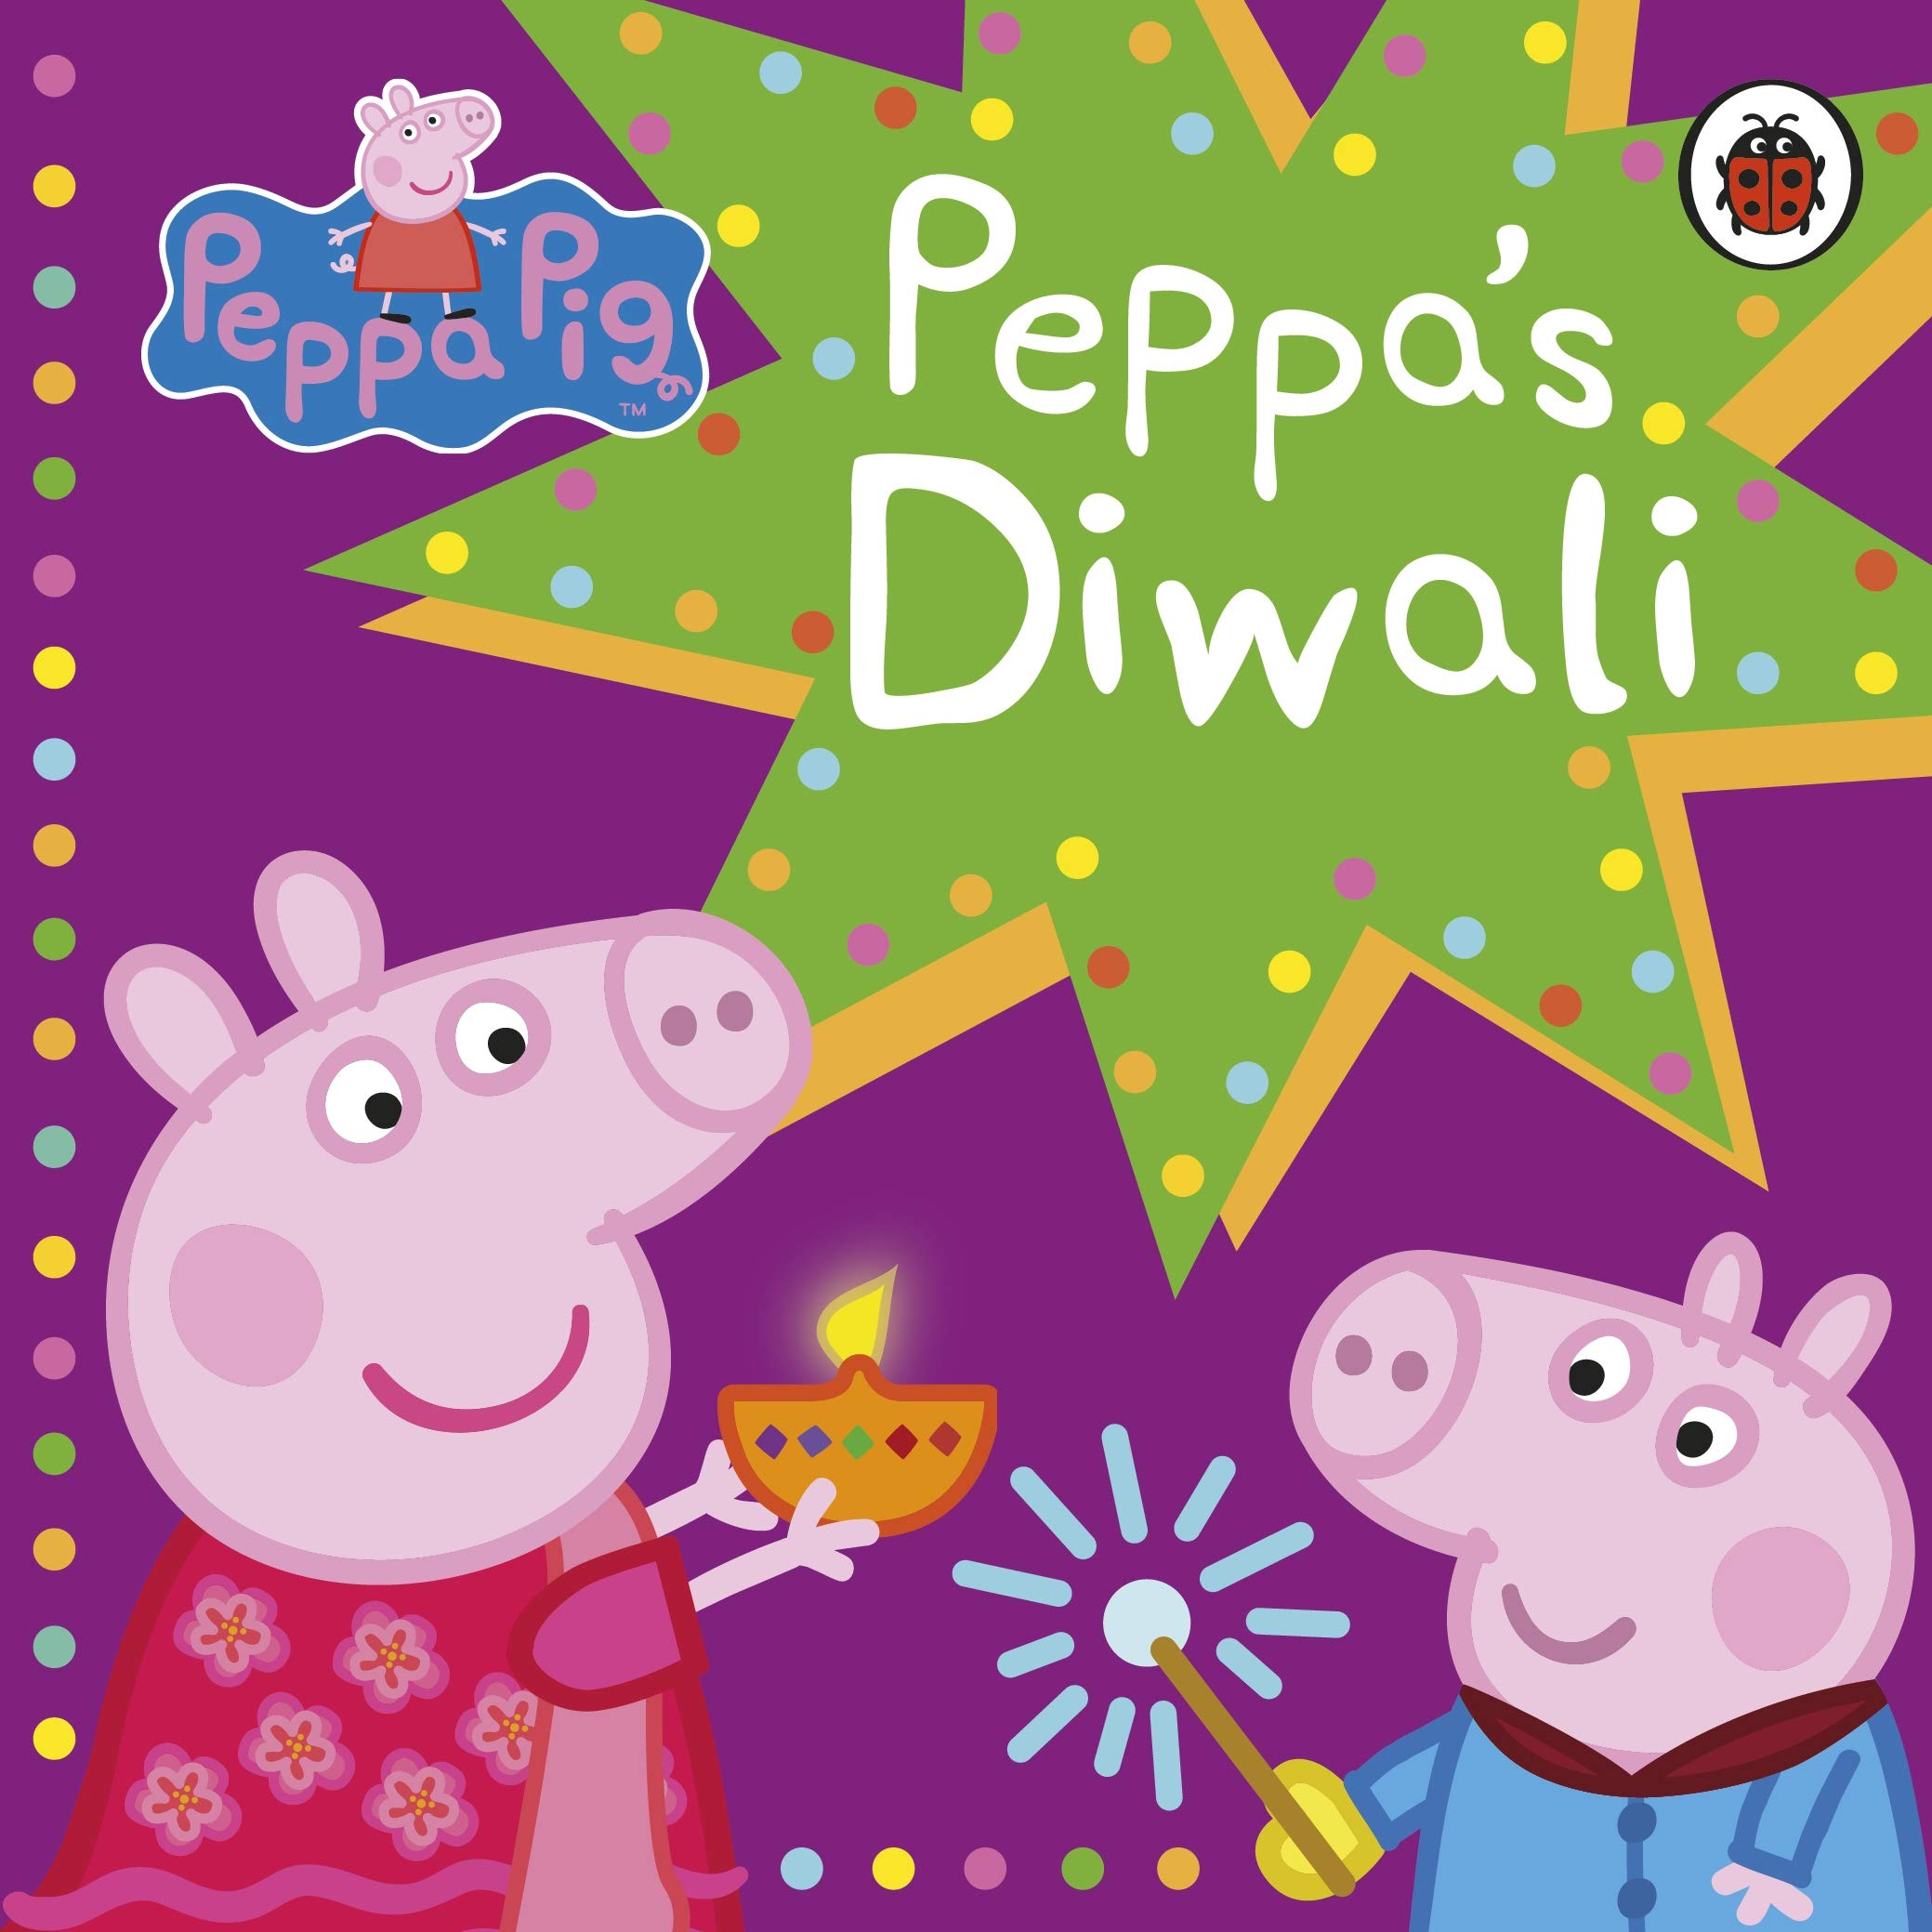
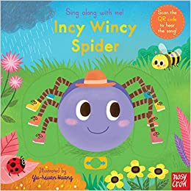
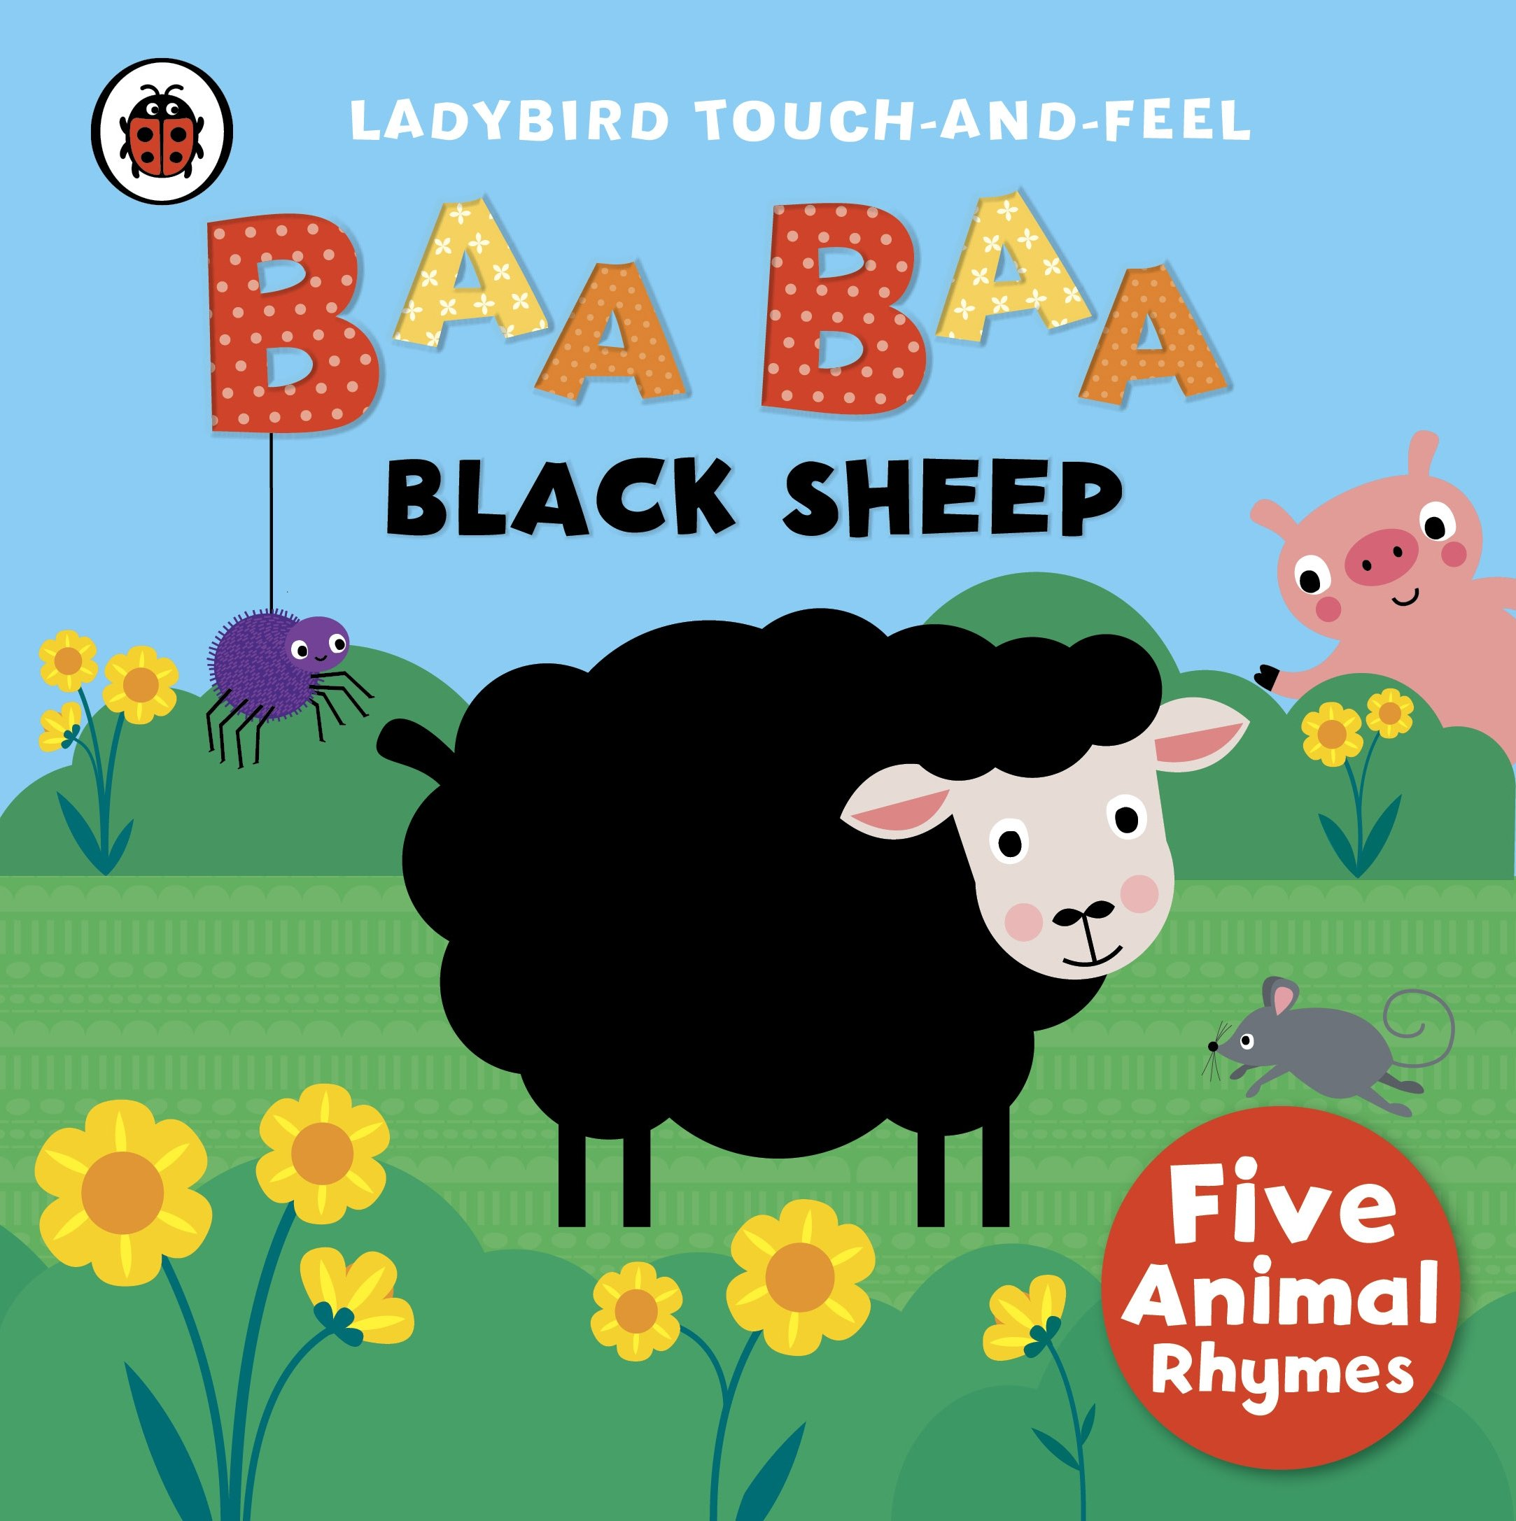

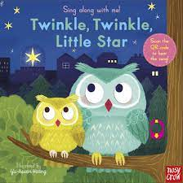
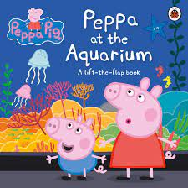
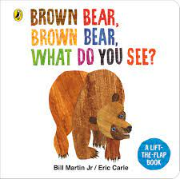
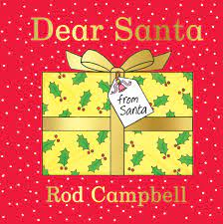
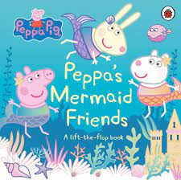
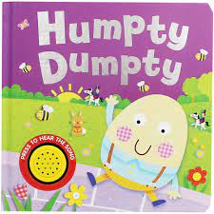
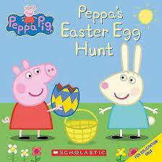
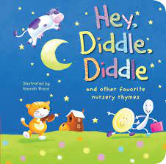
Autumn 1 : About Me | Spring 1: Favourite Stories | Summer 1: Farm
Autumn 2: Colour | Spring 2: Nursery Rhymes | Summer 2: Seaside

Slide 3


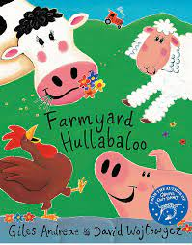
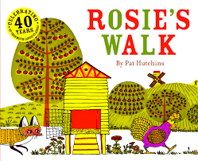

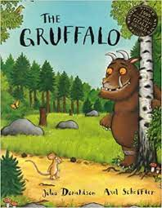
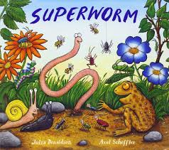
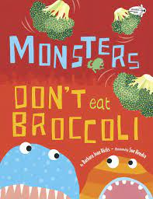

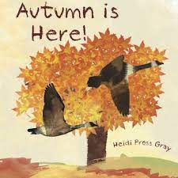
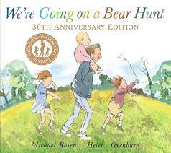
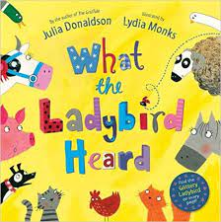
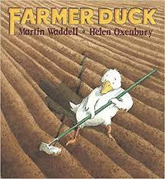
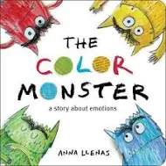

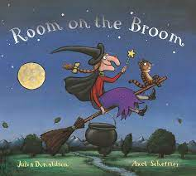
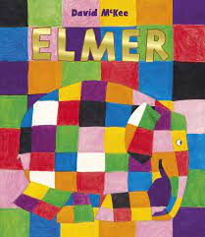

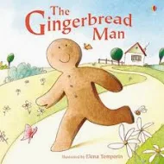
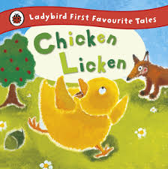
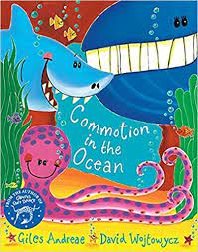
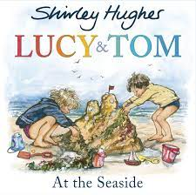
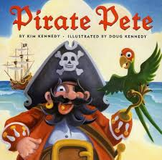
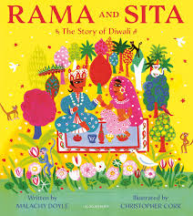
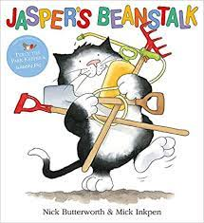
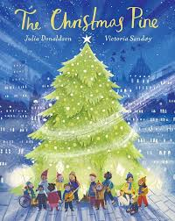
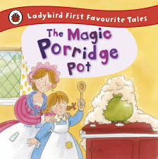
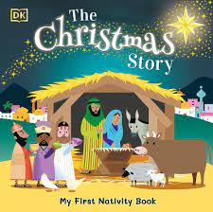
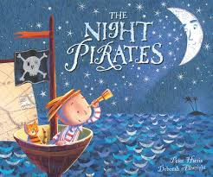
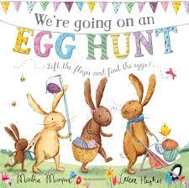

Autumn 1 : About Me | Spring 1: Favourite Stories | Summer 1: Farm
Autumn 2: Colour | Spring 2: Fairytales | Summer 2: Seaside

Slide 4
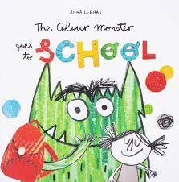
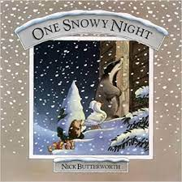
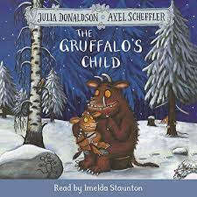
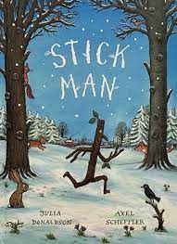
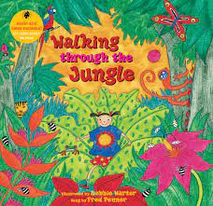


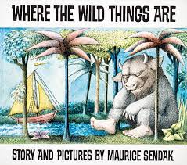



























Autumn 1 : Healthy Me/ Autumn | Spring 1: Winter/ Favourite Stories | Summer 1: Jungle
Autumn 2: Festive Fun | Spring 2: Spring/ Fairytales | Summer 2: Seaside Town / Cultures

Slide 5












Autumn 1 : | Spring 1: | Summer 1:
Autumn 2: | Spring 2: | Summer 2:

Slide 6












Autumn 1 : | Spring 1: | Summer 1:
Autumn 2: | Spring 2: | Summer 2:

